Slide 1

Module 10: Genome Annotation
Eugene Gardner
Postdoctoral Fellow, Wellcome Sanger Institute
e : eg15@sanger.ac.uk
: @DrGeneUK

Slide 2
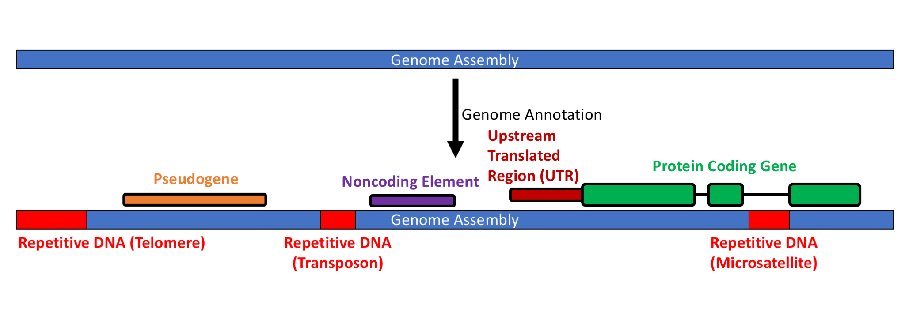
We finished genome assembly… what next?
Genome assembly identifies the DNA sequence of an organism

Slide 3
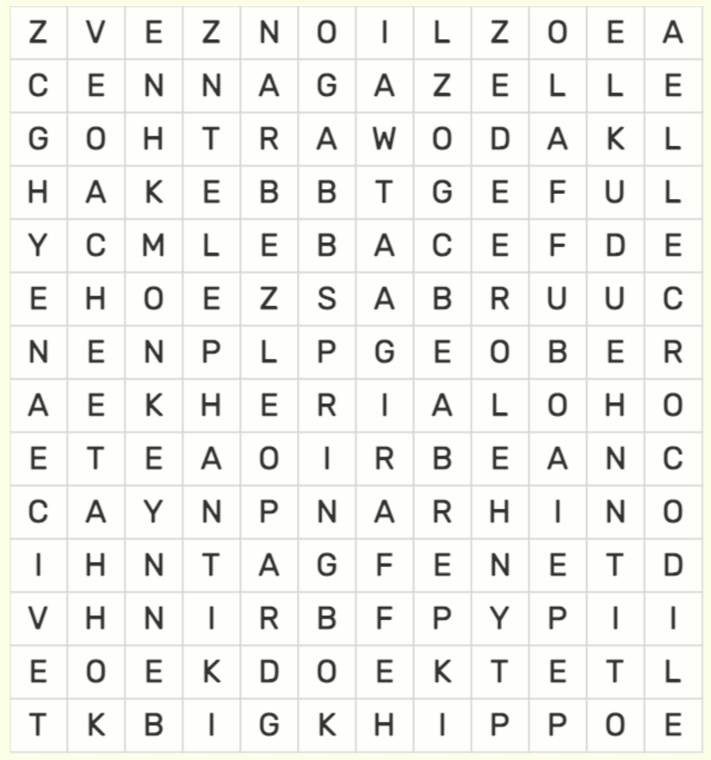
We finished genome assembly… what next?
Genome assembly identifies the DNA sequence of an organism
What do the letters actually tell us?
Function?
Evolution?
Development?

Slide 4
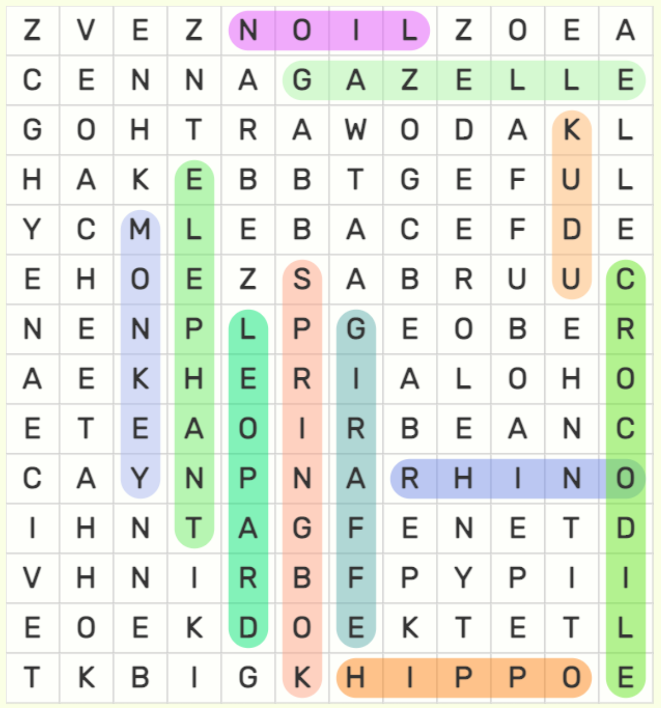
We finished genome assembly… what next?
Genome assembly identifies the DNA sequence of an organism
What do the letters actually tell us about an organism?
Function?
Evolution?
Development?

Slide 5
We finished genome assembly… what next?
UnTranslated
Genome Annotation – The process of assigning meaning to the sequence of a genome
Genomes have many different types of sequences
Some sequences can be assigned to a specific category
Genes
Repetitive Sequence
Functional elements (i.e. enhancers / silencers)

Slide 6


What is a Gene?
Something

Slide 7
What is a Gene?
A T G G A C C A G A A G A A G T G G A C A A C A G C C A T G A C A T A G
DNA
Transcription
A U G G A C C A G A A G A A G U G G A C A A C A G C C A U G A C A U A G
mRNA
Translation
MET-ASP-GLN-LYS-LYS-TRP-THR-THR-ALA-MET-THR-X
protein

Slide 8
Genes in Bacteria
Images from the public domain

Slide 9
Genes in Bacteria
A T G G A C C A G A A G A A G T G G A C A A C A G C C A T G A C A T A G
Start Codon
Other Codons (Different Amino Acids)
Stop Codon
Images from the public domain

Slide 10
Genes in Bacteria
A T G G A C C A G A A G A A G T G G A C A A C A G C C A T G A C A T A G
Start Codon
Other Codons (Different Amino Acids)
Stop Codon
Images from the public domain

Slide 11
Genes in Bacteria
A T G G A C C A G A A G A A G T G G A C A A C A G C C A T G A C A T A G
Start Codon
Other Codons (Different Amino Acids)
Stop Codon
Images from the public domain

Slide 12
Simplest Gene Discovery
Open Reading Frame (ORF)
A T G G A C C A G A A G A A G T G G A C A A C A G C C A T G A C A T A G
Start Codon
Other Codons (Different Amino Acids)
Stop Codon

Slide 13
Genes in Eukaryotes
Splice Donor
Splice Acceptor
Exon
Exon
Intron
A T G G A C C A G A A G A A G T G G
GT--------AG
A C A A C A G C C A T G A C A T A G
DNA
Transcription
A U G G A C C A G A A G A A G U G G
GU--------AG
A C A A C A G C C A U G A C A U A G
pre-mRNA
Splicing
A U G G A C C A G A A G A A G U G G A C A A C A G C C A U G A C A U A G
mRNA
Translation
MET-ASP-GLN-LYS-LYS-TRP-THR-THR-ALA-MET-THR-X
protein

Slide 14
Frame
Open Reading Frame (ORF)
1
A T G G A C C A G A A G A A G T G G A C A A C A G C C A T G A C A T A G
2
T G G A C C A G A A G A A G T G G A C A A C A G C C A T G A C A T A G A
3
G G A C C A G A A G A A G T G G A C A A C A G C C A T G A C A T A G A T
Same as 1…
G A C C A G A A G A A G T G G A C A A C A G C C A T G A C A T A G A T C
And also the reverse complement…

Slide 15
Genes in Eukaryotes
Intron
Intron
Exon
Exon
Exon

Slide 16
Genes in Eukaryotes
Intron
Enhancer/silencer(s)
Intron
Exon
Exon
Exon

Slide 17
Genes in Eukaryotes
5’ UnTranslated Region
3’ UnTranslated Region
Intron
Enhancer/silencer(s)
Intron
Exon
Exon
Exon

Slide 18
Genes in Eukaryotes
Topologically Associating Domains (TADs)
Topologically Associating Domains (TADs)
5’ UnTranslated Region
3’ UnTranslated Region
Intron
Enhancer/silencer(s)
Intron
Exon
Exon
Exon
Splicing Branch Point
Poly(A) site

Slide 19
What is a Gene?
Topologically Associating Domains (TADs)
Topologically Associating Domains (TADs)
5’ UnTranslated Region
3’ UnTranslated Region
Intron
Enhancer/silencer(s)
Intron
Exon
Exon
Exon
Splicing Branch Point
Poly(A) site
There is no one right answer!

Slide 20
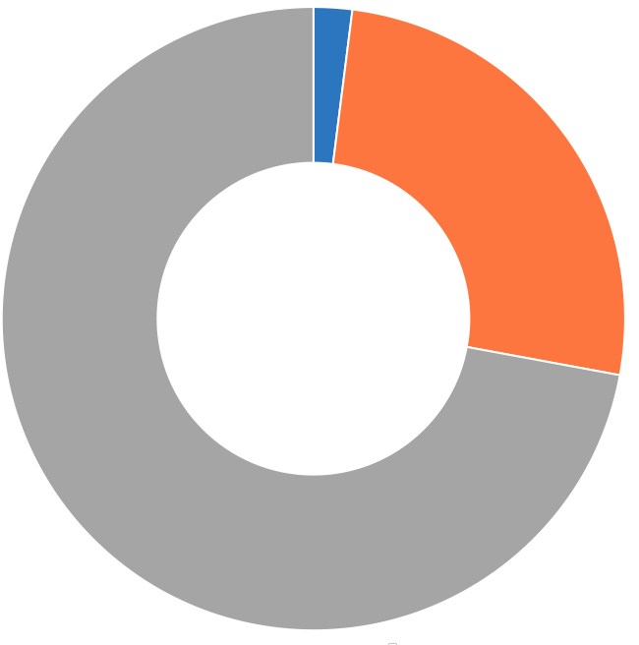
Human Genome Composition
Exons (~2%)
Introns (~30%)
What is all this?
(~70%)

Slide 21
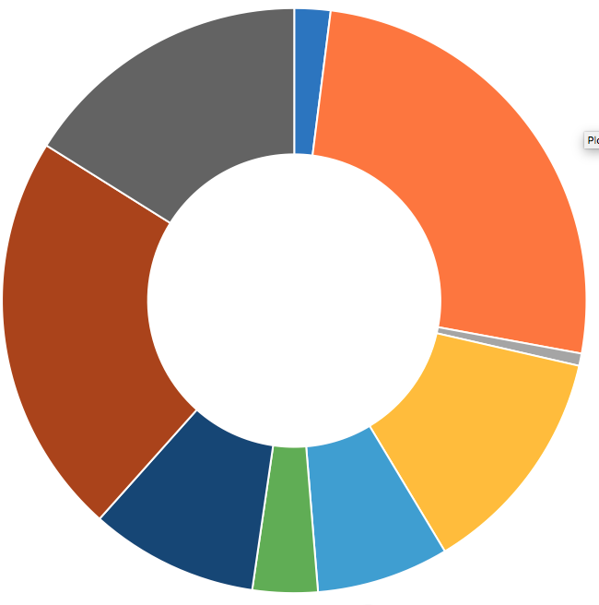
Human Genome Composition
Exons (~2%)
SINEs
(Alu, SVA, others)
Introns (~30%)
LINEs
Endo. RVs
Repeats (~60%)
Retrotransposons (~50%)

Slide 22
Human Repeat Classes
Simple
[ATCG] * N
AAAAAAAA…
Homopolymer tract
[ATCG][ATCG] * N
ATATATATAT…
Low complexity repeat
([ATCG] * N) * N
ATGATGATG…
([ATCG]* N>2) * N
TTAGGGTTAGGG…
Satellite DNA
N/A
GGGCCGGGTGC…
Transposons
Complex

Slide 23
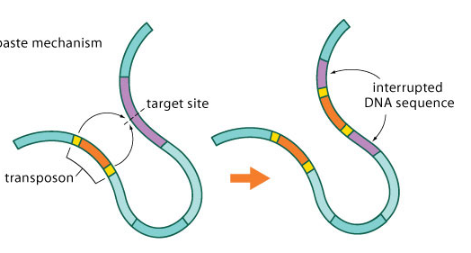
Human Retrotransposition
Mobile Element Insertion
(MEI)
Mobile Element
RNA
Cordaux, R., & Batzer, M. A. The impact of retrotransposons on human genome evolution. (2009). Nat Rev Genet. PMID: 19763152.
Mills, R. E., Bennett, E. A., Iskow, R. C., et al. Which transposable elements are active in the human genome? (2007). Trends Genet. PMID: 17331616.

Slide 24
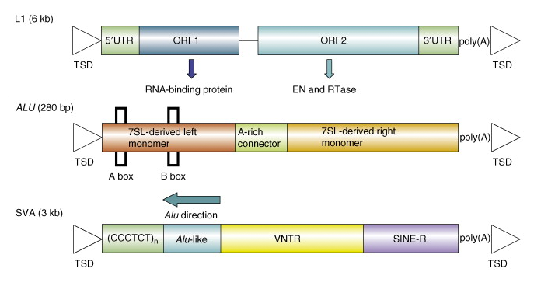
Human Retrotransposition
L1-6kbp
Alu-300bp
RNA
SVA-3kbp
Cordaux, R., & Batzer, M. A. The impact of retrotransposons on human genome evolution. (2009). Nat Rev Genet. PMID: 19763152.
Mills, R. E., Bennett, E. A., Iskow, R. C., et al. Which transposable elements are active in the human genome? (2007). Trends Genet. PMID: 17331616.

Slide 25
Genome Annotation
UnTranslated

Slide 26
Genome Annotation – Steps
Identifying non-coding portions of the genome – Repeat Masking
Discovery of functional elements – Discovery
Attaching meaning to functional elements – Annotation
Review of predictions – Manual Curation

Slide 27
Repeat Masking – Why Are Repeats a Problem for Genome Annotation?
Transposons can contain ORFs
Erroneous gene discovery
Incorrect splicing
Exon
Exon
Exon
Transposon
X

Slide 28
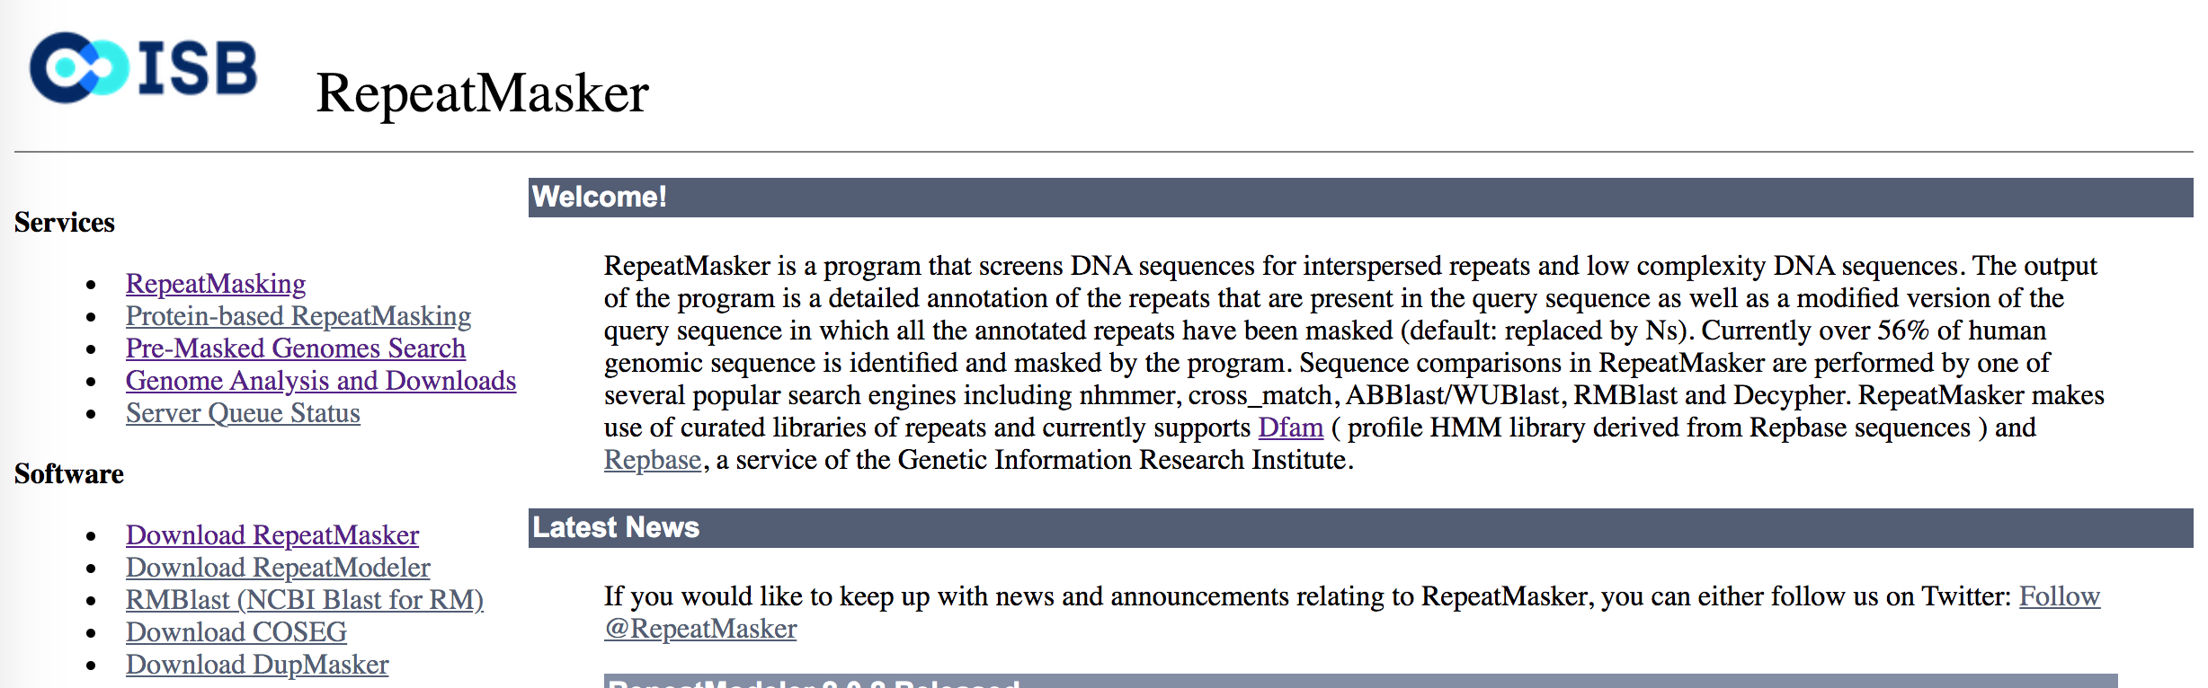
Repeat Masking – RepeatMasker
https://www.repeatmasker.org
Developed by Arian Smit and colleagues in the 90s
Used to identify repeat sequences in the human genome project
Uses a Hidden Markov Model

Slide 29
Repeat Masking – RepeatMasker
TAAGCTTCGTACCCCGAACGATCACAGTTGAAGGCGTTACGGTAACTCTCTCTCTCTCTC
TCTCTCTCTCTCATGTTGACGACAATCGAGGGCGGCTATAAGATAAGGGTCATCTATCTA GAAGAAGAAGAAGAAGAAGAAGAAGAAGAAGAAGGGCACTTGTGTGTGTAAGGCCGAGTC ATCGATACTTGGTGTTTCGCGTGAGCACTGGAGTACTTGCACAATGCGTGAAGCGACACG GCGACCATGCCTAGGTACGGCGAGCGCAGACGATATCAAAACGGGCGTTAGGGAACGCCG TCTGAGACAGACCGGTTTTTTTTTTTTTTTTTTTAGACTTAGCGCTGAGGAACCATTGAC
Library of transposons, satellite sequences, repeats, etc.
Hidden Markov Model
TAAGCTTCGTACCCCGAACGATCACAGTTGAAGGCGTTACGGTAActctctctctctctc
tctctctctctcATGTTGACGACAATCGAGGGCGGCTATAAGATAAGGGTCATCTATCTA gaagaagaagaagaagaagaagaagaagaagaaGGGCACTTGTGTGTGTAAGGCCGAGTC ATCGATACTTGGTGTTTCGCGTGAGCACTGGAGTACTTGCACAATGCGTGAAGCGACACG GCGACCATGCCTAGGTACGGCGAGCGCAGACGATATCAAAACGGGCGTTAGGGAACGCCG TCTGAGACAGACCGGtttttttttttttttttttAGACTTAGCGCTGAGGAACCATTGAC

Slide 30
Discovery - Types
Ab initio – “from the beginning”
Identification of genes purely from the sequence of the genome
“Find me all possible open reading frames, sort them out later.”
Evidence based
Identification of genes based on some prior evidence (other species, RNA-seq data, cDNAs, etc.)
“Find me open reading frames supported by other evidence AND those that look very similar.”

Slide 31
Discovery – Evidence Based
Müller et al. Comparison of transcriptome technologies in the pathogenic fungus Aspergillus fumigatus reveals novel insights into the genome and MpkA dependent gene expression. BMC Genomics (2012).

Slide 32

Discovery – Evidence Based
Gene Predictions
Protein Alignment (GenomeThreader)
… ATG … GT .. AG .. TGA …
Müller et al. Comparison of transcriptome technologies in the pathogenic fungus Aspergillus fumigatus reveals novel insights into the genome and MpkA dependent gene expression. BMC Genomics (2012).

Slide 33
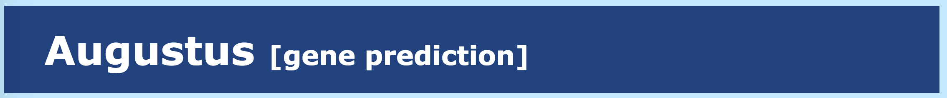
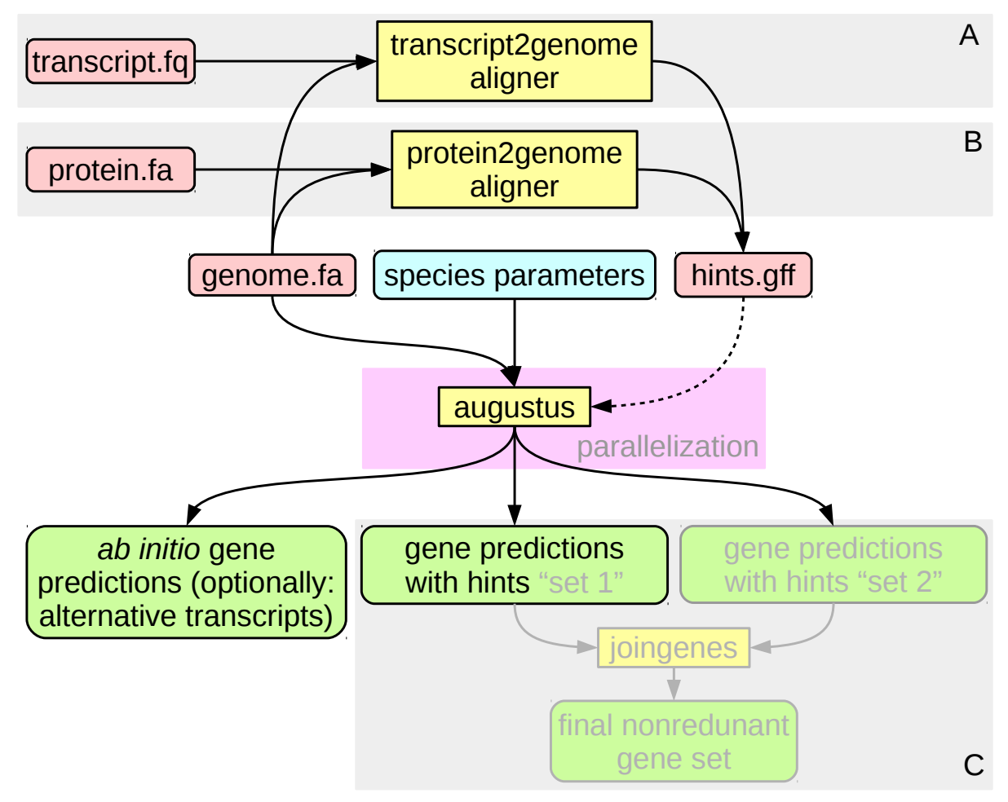
Discovery – AUGUSTUS + GeneMark-ET + BRAKER
Performs ab initio gene discovery with annotation-based training.
Actually a combination of two tools:
AUGUSTUS: ab initio gene discovery
GeneMark-ET: RNA-seq for training gene discovery
Can be run together with BRAKER OR Web-based AUGUSTUS tool
BRAKER2: Automates AUGUSTUS + GeneMark-ET
Input:
.fa file
RNA-seq alignment
Algorithm:
Identify likely open-reading frames ab initio
Evaluate predictions with RNA-seq data
Refine prediction parameters
Perform evidence-based Discovery
Output:
.gff3 format file of likely genes
Hoff and Stanke. Predicting Genes in Single Genomes with AUGUSTUS. Current Prot. Bioinf. (2018).

Slide 34
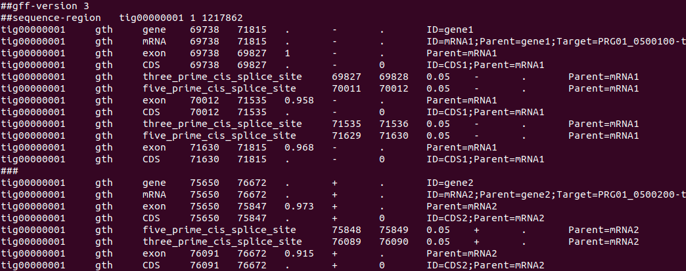
Discovery – GFF3 Format
Gene 1
Gene 2
Contrast to .bed format which has 1 record per-line

Slide 35
Discovery – GFF3 Format
Exon 1
Exon 2
Exon 3
Gene 1
Gene 2

Slide 36
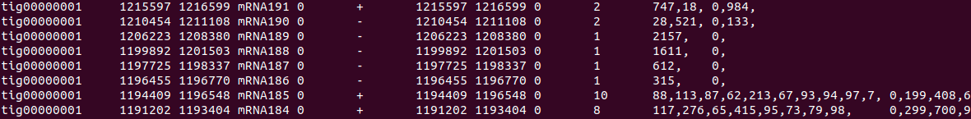
Discovery – BED12 Format
Gene Start
Gene Stop
Exon sizes
Exon starts
Gene 1
Gene 2
Contrast to .gff format where one gene is represented on multiple lines

Slide 37
Discovery – Other Annotations
Pseudogenes – standard gene discovery, screen for degraded ORFs, comparative alignment
Noncoding RNAs – specialized RNA-sequencing protocols
Transcription Factor Binding Sites (Promoters/Enhancers/Silencers) – ChIP-seq

Slide 38
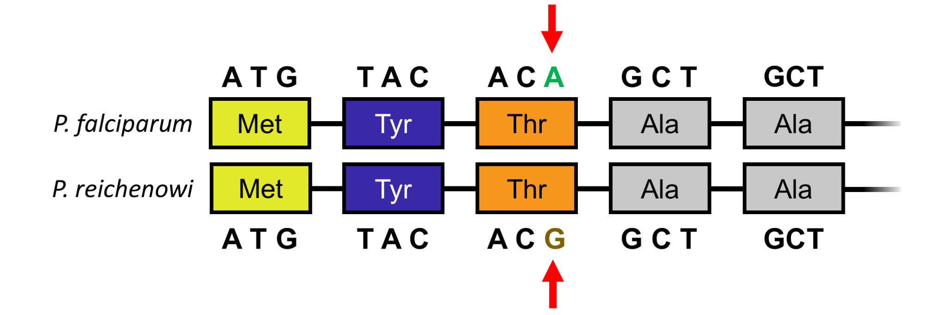
Annotation – Sequence Homology
Liver Cell Invader Gene

Slide 39
Annotation – Sequence Homology
Liver Cell Invader Gene
Liver Cell Invader Gene?

Slide 40
Annotation – Sequence Homology
Liver Cell Invader Gene
Liver Cell Invader Gene!
Alignment of protein sequences while taking into account redundancy in the amino acid code

Slide 41
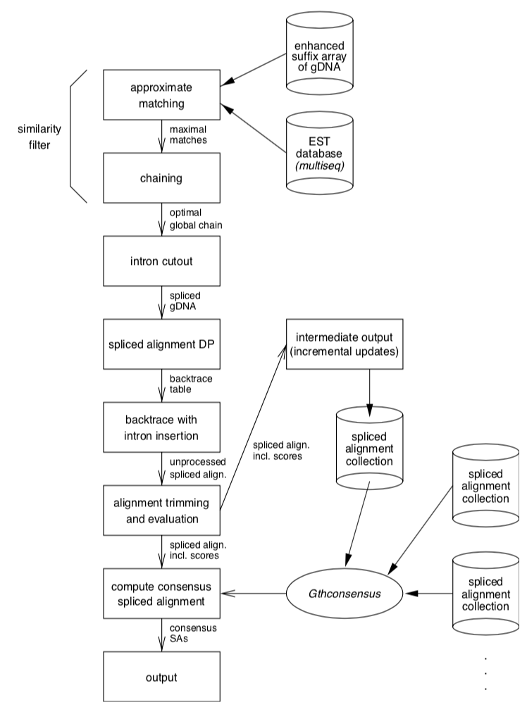
Annotation – GenomeThreader
Aligns protein sequence to DNA
Takes into account wobble position
Input:
.fa file of organism being annotation
.fa file of protein sequence of already annotated organism
Algorithm:
Approximately match protein → .fa in size N chunks
Merge chunks via spliced alignments
Output:
.gff3 format file of likely genes
Gremme et al. Engineering a software tool for gene structure prediction in higher organisms. Information and Software Tech. (2005)

Slide 42
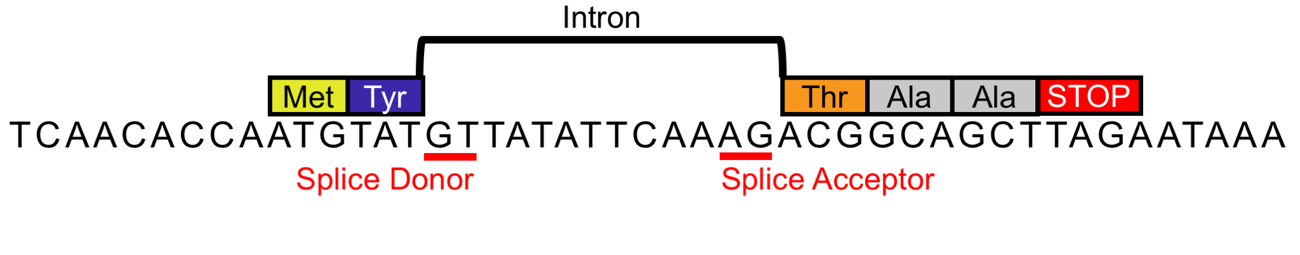
Annotation – GenomeThreader

Slide 43
Manual Curation
Visualisation using tools like IGV alongside evidence (RNA-seq)
Identification of poly-adenylation sites / transcription start sites
Sequence alignment to identify gene function
Wet lab work to identify gene function (knockouts, etc.)

Slide 44


How Genome Annotation Works at Scale – It’s Automated
Genome Sequencing/Assembly
Genome Annotation

Slide 45
Practical Assignment
Genome Annotation for the Plasmodium falciparum chromosome you assembled during the last practical assignment
Repeat Elements (masking)
Gene Discovery
Comparative Genomics

